Slide 1

SENTIMENT PREDICTION THROUGH DEEP NEURAL NETWORK
Yifan(Terri) Zhang, Guankai(Kyle) Sang
Prof. Sang Chin
CAS CS523

Slide 2
Overview
Introduction
Data Preparation
Modeling and optimization
Conclusion

Slide 3
Introduction
With everyday schedules, there is less time to finish a movie
However, what if there was a way to save all that time by choosing to read movie reviews
Making it possible to have a high accuracy on sentiment prediction of movie reviews could go a long way in saving time
One would not need to read each single review and find other people’s attitude on the movies
We achieved possibility by training a multi-layer neural network with IMDB data
Notes:
Nowadays, people rarely have time to finish all movies, even the latest one, therefore movie reviews become a choosing standard. Having a high accuracy on sentiment prediction of movie reviews, people can save their time even more by not reading each single review and still can know others’ attitude on those movies. We trained a Multi-layer neural network with IMDB data imported from Keras. Even the dataset has been already processed, we still need to do word embedding and split validation dataset from training dataset. For increasing the accuracy of our model without overfitting, we changes parameters such as learning rate, epoch, and also adding more hidden layers with proper dropout rates between them.

Slide 4
Data Preparation
Dataset
Coded data
Validation of dataset
Distribution of dataset

Slide 5
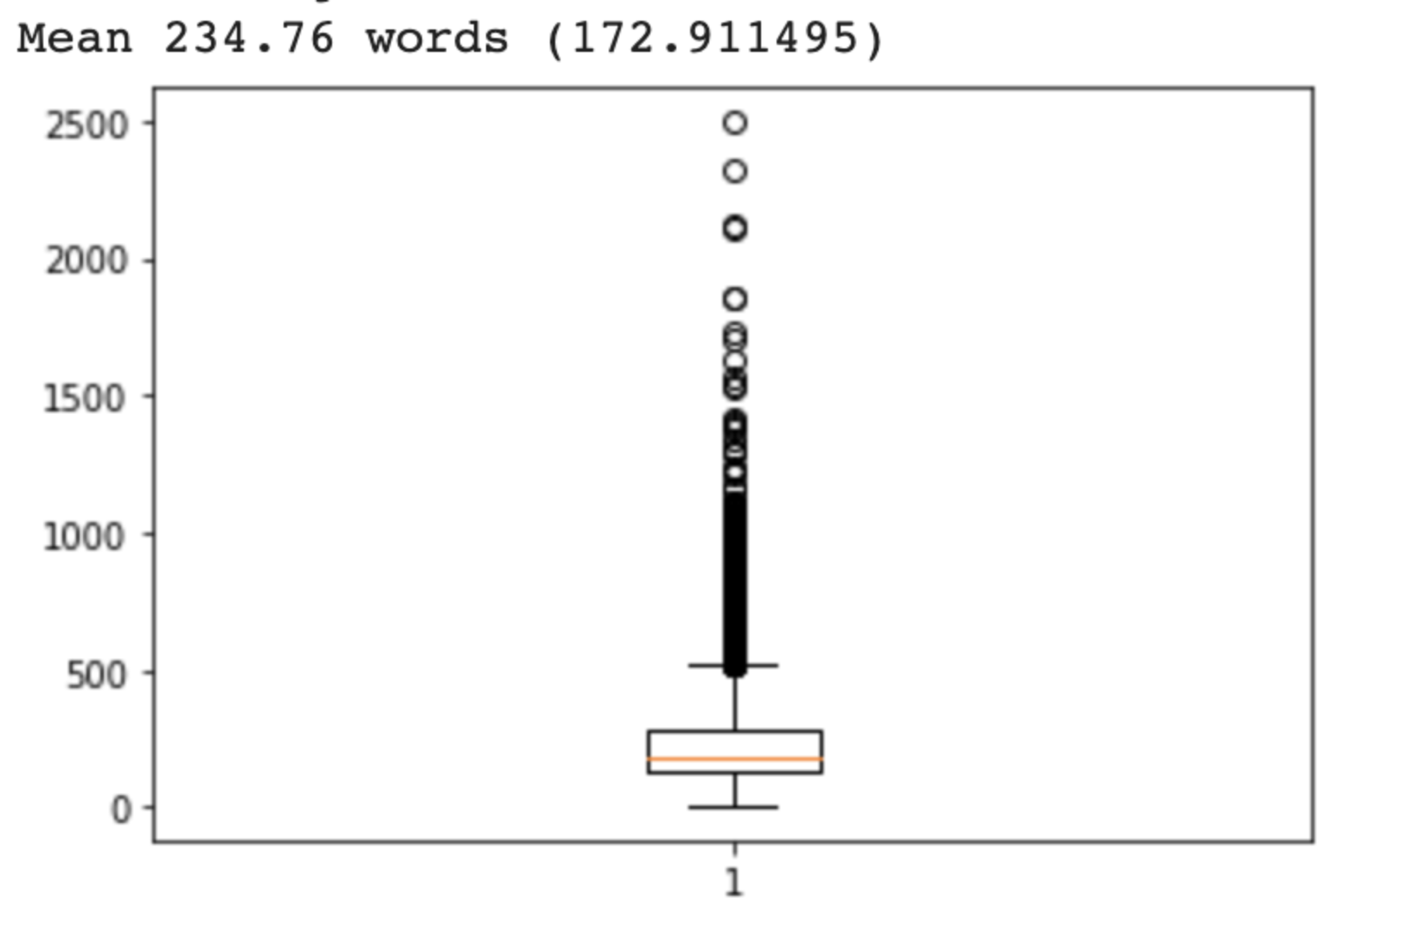
Dataset
Truncate or pad the dataset
Word embedding
Notes:
The dataset will involve mapping words in movie review to a high dimensional vector
Since all neural network requires to have input with same size, we need to truncate or pad the dataset before we do word embedding
It follows that
the mean of review length in IMDB dataset is 234.76 words
standard deviation is 172.911.
from the boxplot, that the maximum of the dataset is around 500
Therefore, even there are multiple outliers that have over 500 word length, we still can set the value of maxlen in pad_sequences function as 500 to cover the most of dataset.
The function will take the original training and testing dataset and truncate reviews longer than 500 or pad reviews shorter than that with 0

Slide 6
Code data
"source": [ "import numpy\n", "from keras.datasets import imdb\n", "from matplotlib import pyplot\n", "from keras.datasets import imdb\n", "import tensorflow as tf\n", "from keras import regularizers\n", "from keras.layers import Dropout\n", "from keras.models import Sequential\n", "from keras.layers import Dense\n", "from keras.layers import Flatten\n", "from keras.layers.embeddings import Embedding\n", "from keras.preprocessing import sequence\n", "from sklearn.model_selection import train_test_split\n", "import matplotlib.pyplot as plt" ], "execution_count": null, "outputs": []
Notes:
Shown above is a The code data shows the possibility of importing data from Keras that will be used to predict reviews of movies. With the data, it is possible to validate it to ensure accuracy of models and that the model used in predicting reviews is highly effective. As shown above, there is a range of data sets to be imported so that the model considers all the reviews and makes it possible to predict without fail.

Slide 7
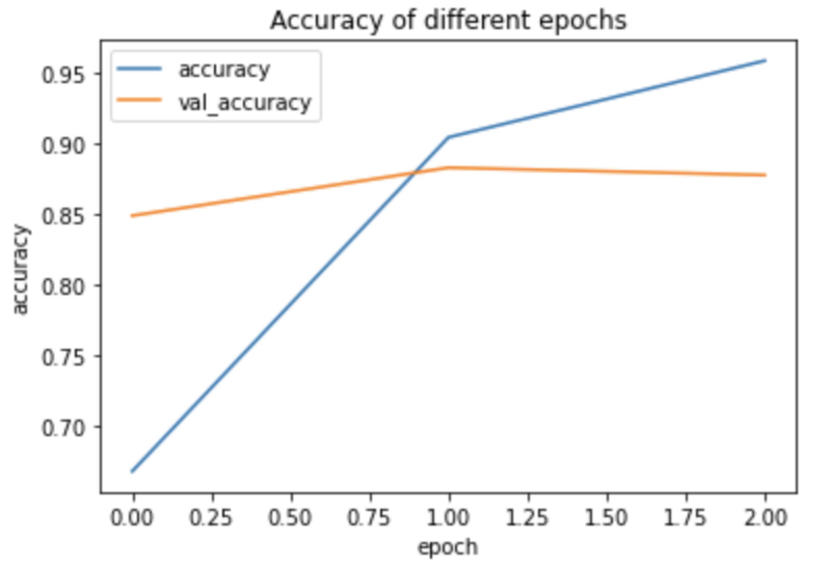
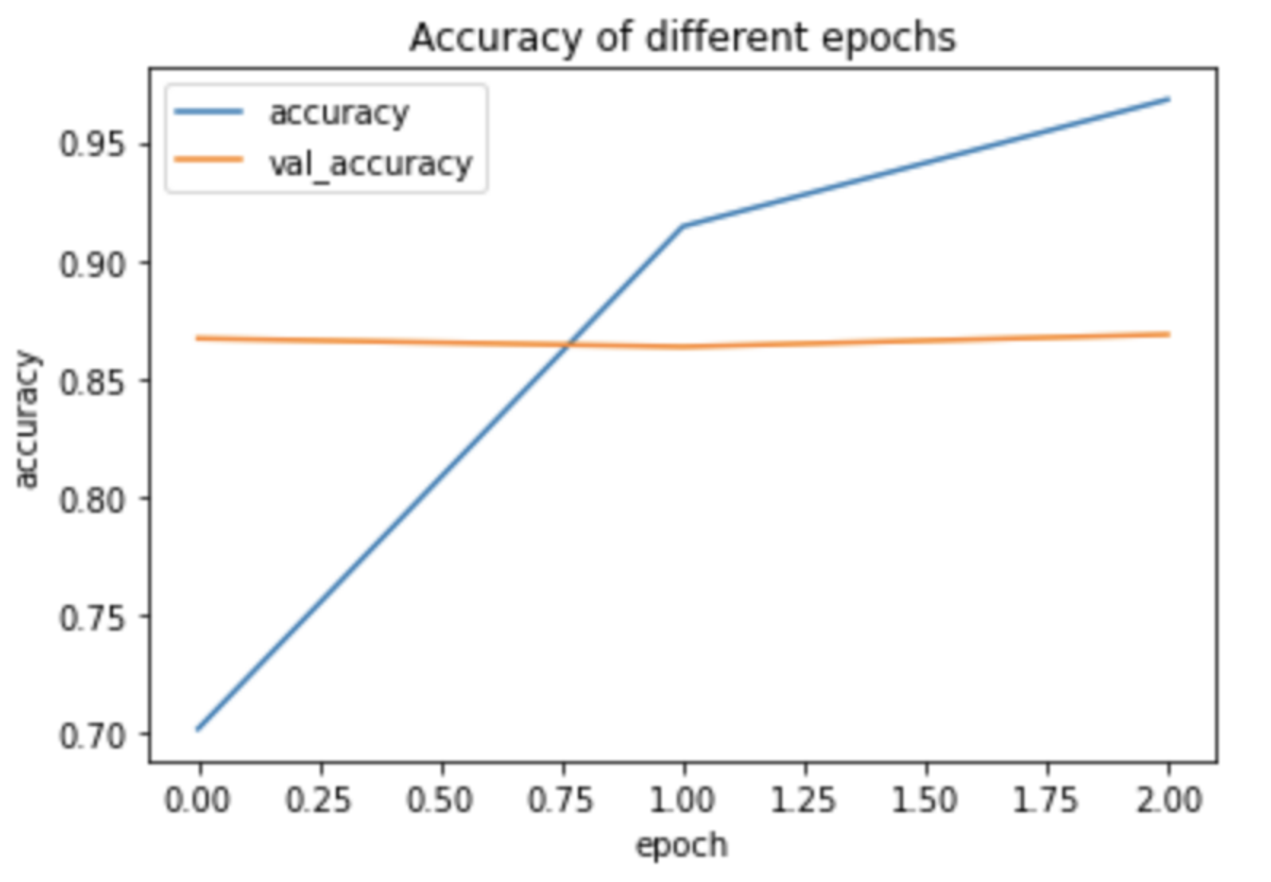
Validation of dataset
Notes:
The figures shown depict the accuracy of models with or without validation dataset. A major challenge of training a neural network is overfitting, which means that a model acts so well on training dataset, but not on new coming dataset. One of way to solve it is through validation dataset in order to update parameters of model so that model will act well on general data.
By training a multi-layer models with extra validation dataset or not, we can see the accuracy difference between them. Figure 2 shows that the validation accuracy of model with no extra validation decreases from the first epoch when the accuracy of the model continuously increases. However, the validation accuracy of model with extra validation dataset decreases after the first epoch. This means without extra validation dataset, model will become overfitting earlier.

Slide 8
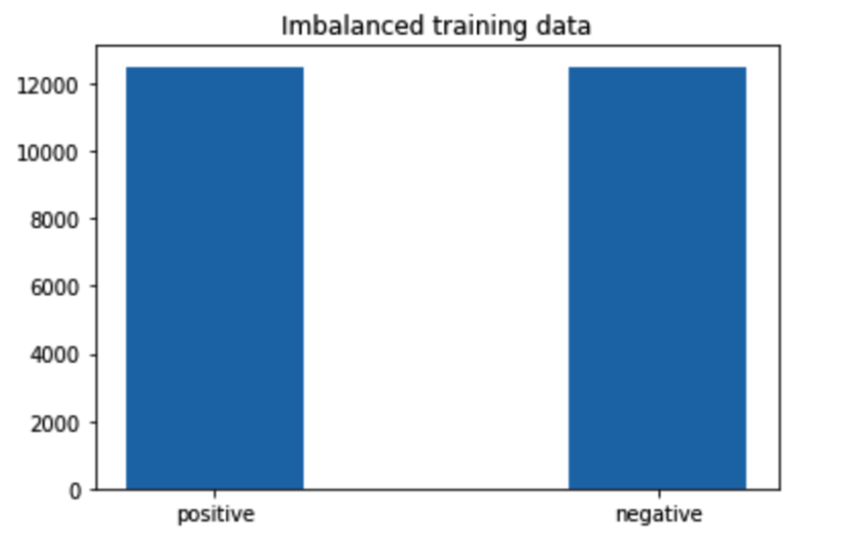
Distribution of dataset
The standard: Imbalance/balance
The result bias due to category with different number of data
Notes:
In order to check the power of our model, we need to have a standard. The most common one is accuracy, but if our dataset is imbalanced, then we cannot use it, since each category with different number of data may cause the bias of the result, model might give a better accuracy result for the category with more training data, so the value of accuracy will not be stable and reliable. For our training dataset shown in Figure 2, it is balanced, so accuracy is available as the standard for our future tests.

Slide 9
Modeling and optimization
Learning rates
Hidden layer
Dropout Layer
Notes:
The starting model that we build has one word embedding layer, a flatten layer, and two dense layers. Output of embedding layer is 32×500, since we would like to have word vector in 32 dimensions and the input length at 500 as discussed previously. Activation for the hidden layer is Relu, and that for the output layer is Sigmoid in order to get results in percentage. Optimizer is Adam with learning rate 0.0005. Training this model in three epochs with extra validation dataset, we get model accuracy around 87% and early overfitting.

Slide 10
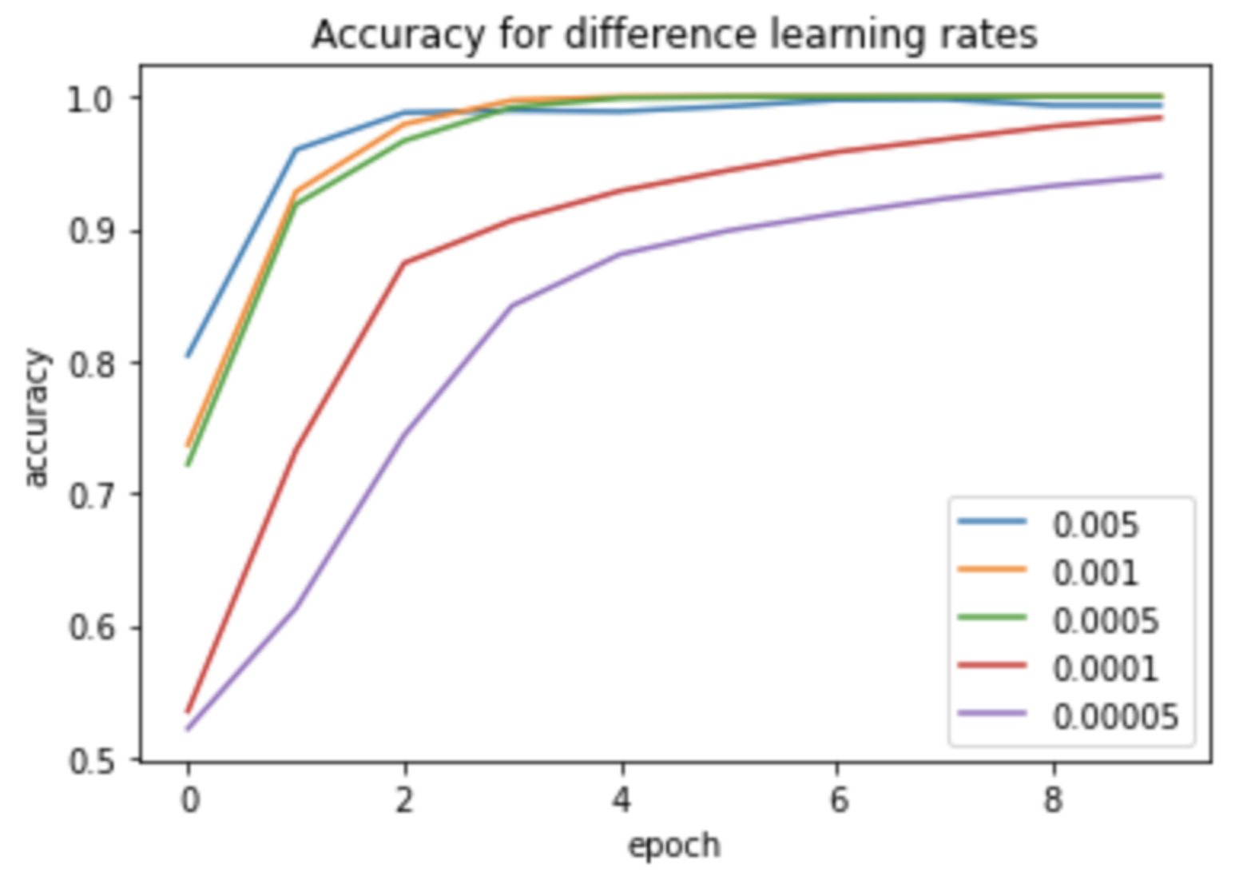
Learning Rate
Figure 3
Table 2
Learning rate | Overfitting | Accuracy
0.005 | Epoch 2 | 0.8042
0.001 | Epoch 3 | 0.9281
0.0005 | Epoch 3 | 0.9184
0.0001 | Epoch 7 | 0.9442
0.00005 | Epoch 10 | 0.9393
Notes:
One of the way to avoid overfitting is picking a proper learning rate, which can help model get higher accuracy before overfitting appears. Shown as Figure 3, learning rate in 0.005, which is our starting learning rate, it has highest starting accuracy, and it can even reach closely to 1 at the end. However, from Table 2, we can see that even model with learning rate 0.005 has highest model accuracy at the beginning, it gets overfitting earlies as well, and when the accuracy at that time is just around 80%. Among all the learning rate value, 0.0001 gives the best result. Its model accuracy before overfitting is 94.42%, which is the highest score than others. Therefore, we changes learning rate to 0.0001.

Slide 11
Hidden Layer
Increasing accuracy using deeper layer
More layers makes it complex and hence overfitting
Layer number | Neuron number | Model accuracy before overfitting | Val accuracy
1 | 10 neuron | 0.9614 | 0.8695
2 | 12 neuron | 0.9526 | 0.8762
3 | 14 neuron | 0.9701 | 0.8618
Notes:
Another way to increase the accuracy of the model is having deeper layer. However, having more layers also means more parameters and more complex model, which could cause overfitting. Therefore, choice on neuron number and balance between neuron and depth of the model becomes important.
By using Early Stopping function with patience value 2, we will get the accuracy of the model before validation accuracy decreases too much, which caused by overfitting. The result is shown as Figure 4.

Slide 12
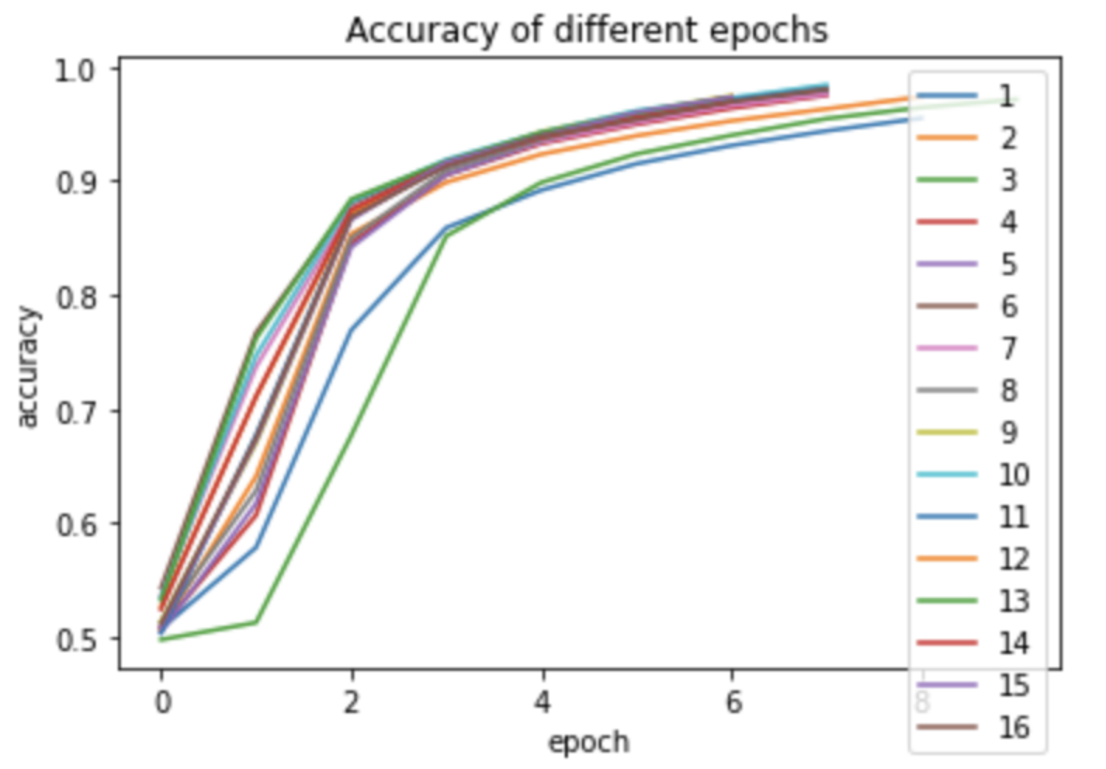
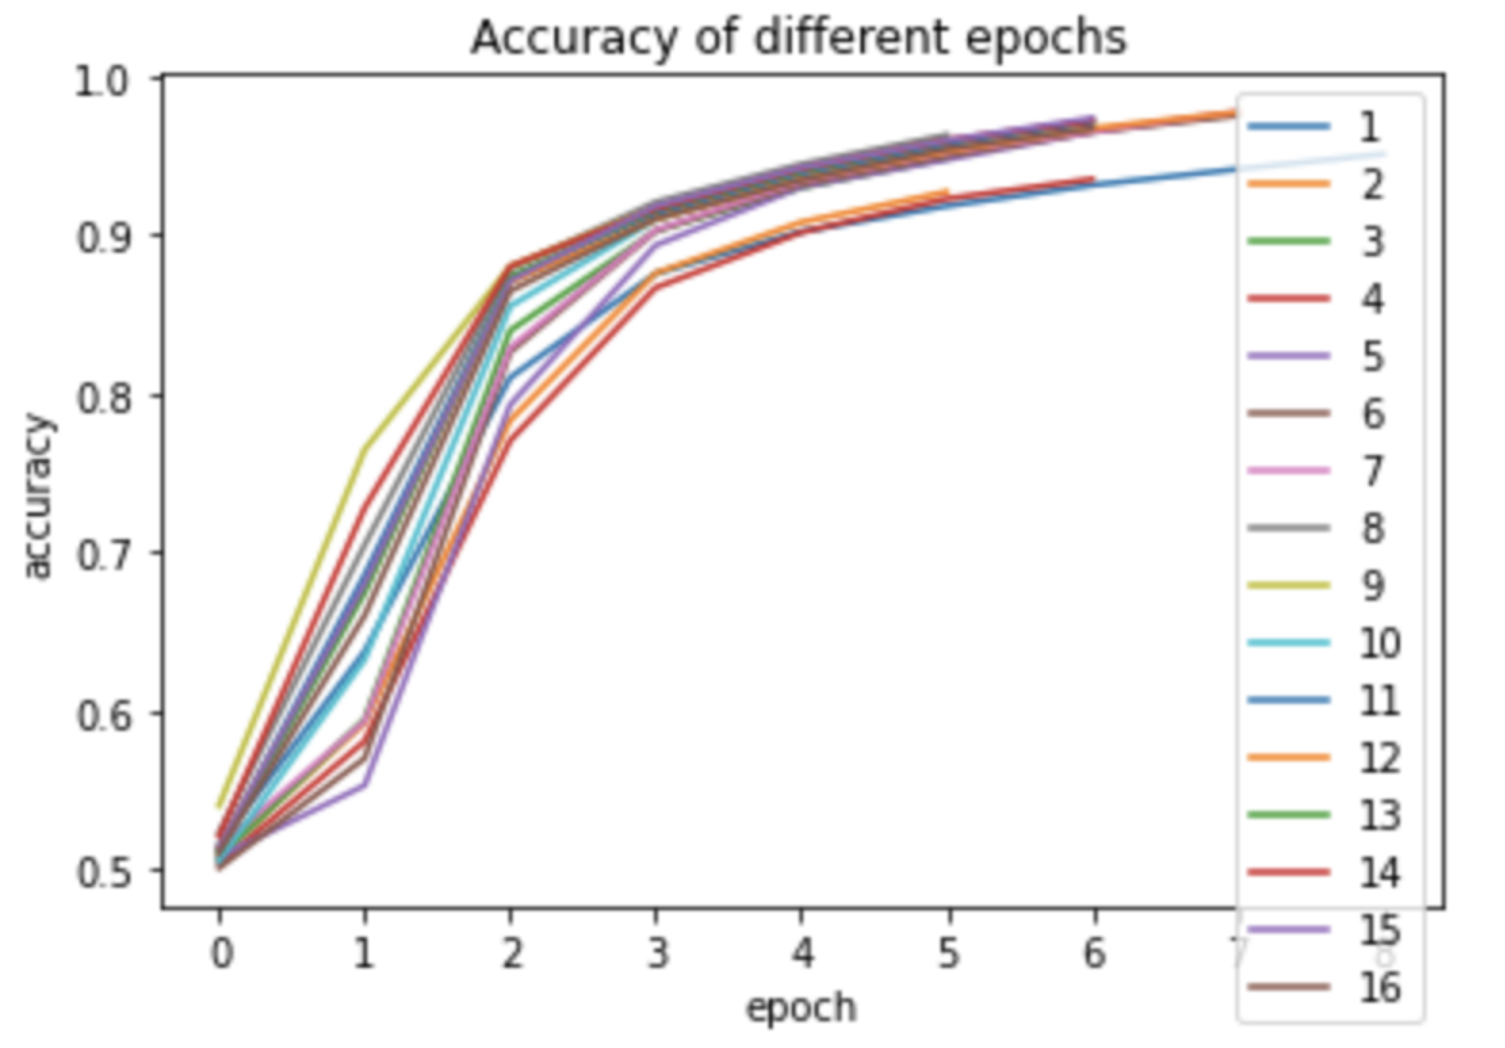
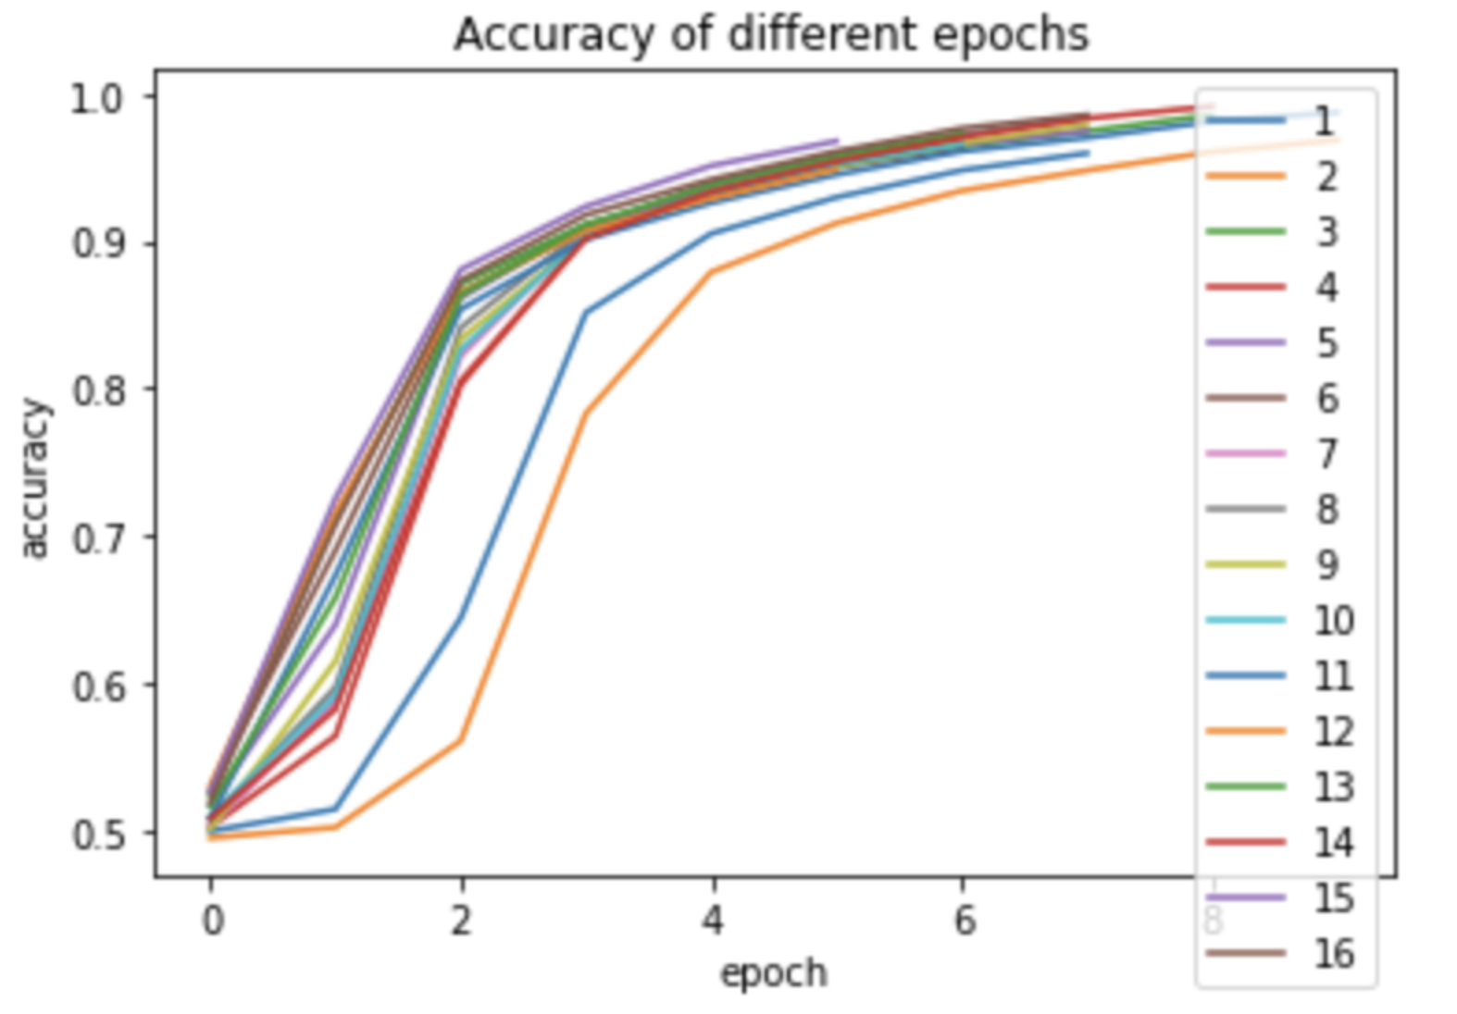
Part a
Part b
Part c
Notes:
From part (a), we can clearly see that for the first layer, 10 neurons gives the highest accuracy before overfitting, and for the second layer, seeing from part (b), we get the highest accuracy with 12 neurons. In part (c), models with 14 neurons gives the best result. However, shown in Table 3, the validation accuracy of the model with either only one hidden layer or three hidden layers is not as good as the model with two hidden layers. Therefore, we will only use two hidden layers, one with 10 neurons and the other with 12 neurons.

Slide 13
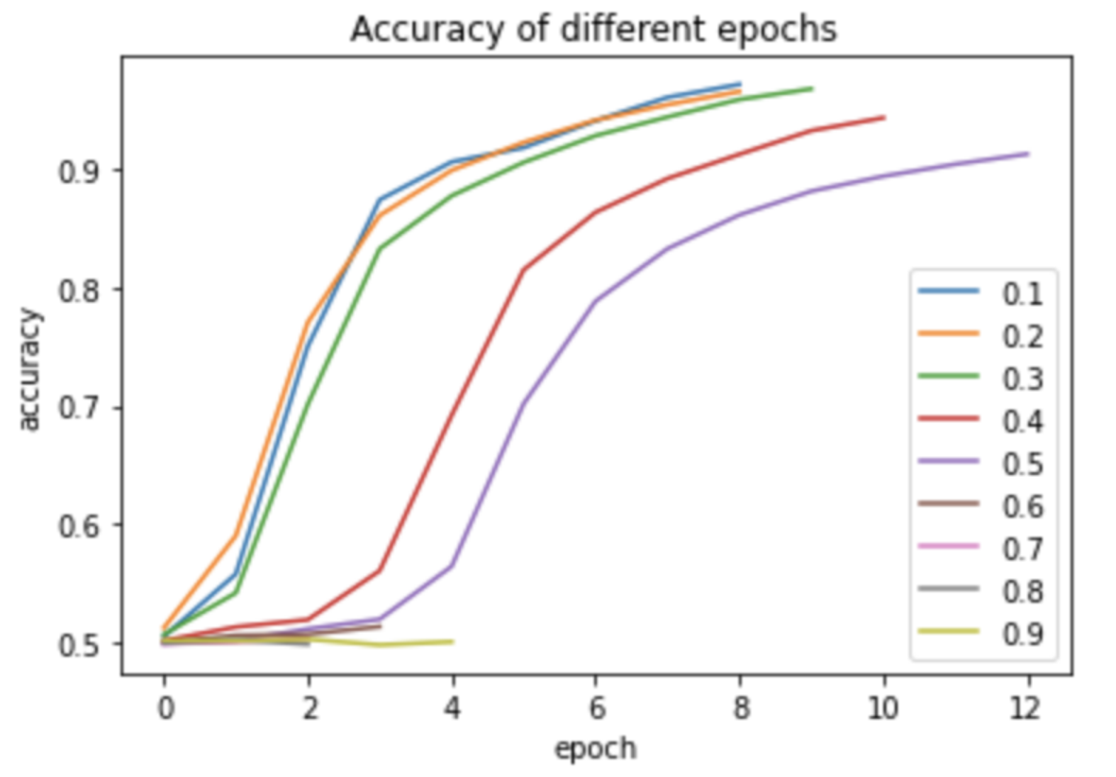
Dropout Layer
Figure 5: Accuracy with various dropout rates
Dropout layer prevent overfitting
High accuracy at 0.3 dropout rate
Final model will not contain dropout layer.
Notes:
Adding a dropout layer after dense layer helps prevent overfitting as well. Since it drops a percent of neurons due to the setting up dropout rate and then continue training the model, this add some randomness during the training process. Seeing from the Figure 5, we can see that our model achieve highest accuracy when dropout rate equals to 0.3, and the accuracy of the model is 0.9445 and validation rate is 0.8717. Since this does not give a higher model accuracy or validation accuracy, we will not use any dropout layer for our final model.

Slide 14
Conclusion
Accuracy of all four methods
Challenge
Decision on the proper review length .
Words in embedding layer: 500
Improving the model as in the table:
Manipulating learning rate
Adding hidden layer
Changing number of neurons
And trying various dropout rate
Changes | Model Accuracy | Validation Accuracy
Basic Model | 0.7054 | 0.8709
learning rate | 0.9595 | 0.8741
Depth of the model | 0.9526 | 0.8762
Dropout rate | 0.9445 | 0.8717
Notes:
The major challenge in our model is the decision on the proper review length as the input of word embedding layer and on the parameter in the deep neural network to avoid overfitting while increasing the model accuracy. Through the analysis of the distribution of general review length, we decide the input of word embedding layer as 500. By manipulating learning rate, adding hidden layer, changing number of neurons and trying various dropout rate, we improve the model as Table 4. Our final model has learning rate in 0.0001 with two hidden layer. The first hidden layer with 10 neurons and the second with 12 neurons. Even though we get high model accuracy as 0.9526 and validation model as 0.8741, it still can be further improved. In our model, we try to set each dropout layer with the same dropout rate, and it does not give us a better result, but for future improvement, we can make them different according to the specific output of the previous dense layer. We could also try to add 1D convolutional neural network at the front, since before we optimize our basic model, the one with convolutional neural network has higher accuracy around 87%, so if we do further optimization with CNN based our final model, it might return a better result.

Slide 15
REFERENCES
Maas, A., Daly, R. E., Pham, P. T., Huang, D., Ng, A. Y., & Potts, C. (2011, June). Learning word vectors for sentiment analysis. In Proceedings of the 49th annual meeting of the association for computational linguistics: Human language technologies (pp. 142-150).
https://aclanthology.org/P11-1015.pdf
Maas, A., Pham, P., & Wang, Y. Learning Representations for Multi-Dimensional Sentiment Analysis.
https://nlp.stanford.edu/courses/cs224n/2011/reports/amaas-ptpham-ygw.pdf
Zhang, Y., & Wallace, B. (2015). A sensitivity analysis of (and practitioners‘ guide to) convolutional neural networks for sentence classification. arXiv preprint arXiv:1510.03820.
https://arxiv.org/pdf/1510.03820.pdf,

